Slide 1


Data & Evaluation Lead
Recruitment Pack

Slide 2

Contents
1. Football Matters
2. Who would this role suit?
3. Job description
4. Application process

Slide 3
Football Matters
Football is important. As a game, yes. But more so in its role in society. Football is a part of so much of people's lives. It creates impact, for the better. It represents positivity, when there’s so much negativity. It disrupts, when change is needed. It evokes and prompts emotions like nothing else. Its creativity is why it’s rightly known as The Beautiful Game.
Our Purpose
England’s National Football Museum (NFM) exists to house and harness the power of football, to share stories that influence, to showcase culture and involve and motivate people to creatively engage. It’s the place to experience football in all its glory, and the place to experience why football matters.
Our Values
Celebrating: Football is incredible
Football is known all over the world, and we have the honour to host so much of what makes it amazing. We are ambitious for our visitor experience and are proud of how positive people feel when they visit us.
Unifying: Football brings people together
In the passion for their team, for players they love, for the emotions of joy and heartbreak that football evokes, we tell the powerful story of this unification. At NFM, we provide a space where everyone can experience why Football Matters.
Exploring: Football has so much to offer
Football is good, bad and ugly at times. NFM allows people new to the game to understand it’s impact. And NFM shows people who have loved the game for years that there’s always something new for them to discover.
Evolving: Football disrupts to positively make change
Football transcends boundaries and represents the societal changes occurring every day. NFM is proud to be representative, taking action to drive inclusivity and diversity.
Enjoying: Football is fun.
NFM harnesses the fun of the game in its amazing visitor experience. People take part in our creative experience, and they are happy because they are involved. And happiness is a beautiful thing.

Slide 5
Who would this role suit?
This newly created role will lead the collection, management, analysis and evaluation of data, supporting data-informed, evidence-based decision making across the museum.
Reporting to the Director of Finance and Resources the post holder will create clear and engaging data visualisations and insight reports that support strategic and operational decision making. They will also act as the museum’s lead for CRM administration, development and data quality.
The role requires strong skills in data visualisation, including dashboard, charts and insight summaries along with experience using tools such as Power BI or advanced Excel to analyse and present data. It would suit someone who is analytical, collaborative and confident in turning data into meaningful insight and practical recommendations.
We offer:
Competitive and sector-benchmarked salary
Hybrid working policy with a minimum three days a week in the museum in Manchester
25 days annual leave plus Bank Holidays
Medicash, Employee Assistance Programme, life assurance, cycle to work and regular wellbeing activities.

Slide 6
Job Description
Data & Evaluation Lead
Department | Finance & Resources
Grade | C (£34,672 - £40,790 per annum)
Line Manager | Director of Finance and Resources
Contract | Full time, permanent
Hours | 37.5 hours per week across 5 days, Monday to Friday.
Main Duties and Responsibilities:
To lead the collection, management, analysis and evaluation of data, supporting data-informed, evidence-based decision making across the museum.
This role suits someone who is analytical, collaborative and confident in turning data into meaningful insight and practical recommendations.
Management / Supervision:
None
Overall Purpose of the Post:
To act as the museum’s lead for CRM administration, development and data quality
To create clear, engaging data visualisations and insight reports that support strategic and operational decision making
To support consistent data collection and evaluation across the museum, including surveys, audience feedback and staff guidance
To develop practical data capture and evaluation approaches that improve the quality and usefulness of evidence
To provide timely information and analysis for funding applications, KPI reporting and wider business planning
To support reporting and evaluation for key stakeholders and funders, including Manchester City Council and Arts Council England
Key Responsibilities
2.1 CRM Management

Slide 7
Serve as the primary administrator for Microsoft Dynamics 365, managing user permissions and maintaining the key relationship with the external CRM partner
Maintain and improve CRM workflows, dashboards and reporting to support teams including marketing, fundraising, venue hire and retail
Lead data quality processes, including deduplication, cleansing and the development of consistent data standards
Support colleagues to use Dynamics 365 effectively through training, guidance, documentation and day-to-day troubleshooting
Work with the external CRM partner on system updates, integrations, enhancements and issue resolution
2.2 Data Visualisation & Insight Reporting
Consult with stakeholders to develop clear dashboards and visual reports using tools such as Power BI and Excel
Translate datasets into accessible visual formats for senior leaders, colleagues, trustees, funders and other external stakeholders
Produce summaries that highlight trends, visitor behaviour, outcomes and opportunities for improvement
Support teams to interpret and apply visualised data in planning, evaluation and decision making
Provide accurate information and analysis to support reporting, funding applications and business cases as required
2.3 Data Collection & Management
Oversee data collection across the museum, including ticketing, retail, surveys, programme feedback and visitor research
Support the development and adoption of consistent data standards across departments
Ensure data handling complies with UK GDPR, internal data governance policies and ethical data practice
2.4 Evaluation & Impact Measurement
Support colleagues to design proportionate and objective evaluation for exhibitions, learning programmes, community projects and public events
Produce clear, accessible evaluation reports for internal teams, funders and other stakeholders
Support colleagues to capture useful data and evaluation evidence through training, tools and practical guidance
Record and communicate KPIs and impact information internally and to external stakeholders, including Manchester City Council and Arts Council England

Slide 8
2.5 Collaboration & Capacity Building
Work closely with colleagues across departments to embed data-informed practice
Provide training and guidance on CRM use, data visualisation, evaluation methods and ethical data practice
Contribute to funding bids by advising on evaluation approaches, evidence requirements and impact measurement
2.6 Additional Responsibilities
Take positive action to promote equality, diversity and inclusion in all aspects of the work of the NFM
Comply with NFM policies and procedures, including health and safety, safeguarding and data protection
Support income generation and the future sustainability of the museum
Carry out such other duties as may be reasonably expected of the post, including support for exhibitions, activations and digital requirements
KPIs
Reports, dashboards and KPI returns are delivered accurately and in line with agreed deadlines
CRM data quality improves through regular cleansing, deduplication and consistent data standards
Colleagues are supported to collect, interpret and use data and evaluation evidence effectively
Evaluation outputs provide clear evidence of outcomes, impact and learning for internal and external stakeholders
Knowledge, Experience and Skills
Essential
Strong skills in data visualisation, including dashboards, charts and insight summaries
Experience using tools such as Power BI or advanced Excel to analyse and present data
Strong analytical skills, with the ability to interpret complex information and communicate findings clearly
Experience in data collection, evaluation, research or audience insight
Knowledge of qualitative and quantitative research methods
Excellent written and verbal communication skills, including the ability to tailor information for different audiences
Ability to manage multiple projects, priorities and deadlines

Slide 9
Understanding of UK GDPR, data governance and ethical considerations in audience data
Excellent attention to detail and accuracy
A structured and methodical approach to data, evaluation and problem solving
Ability to build effective relationships and support cross-departmental outcomes
Ability to work effectively as part of a team and contribute to shared goals
Clear verbal and written communication skills, with experience communicating with a range of audiences
Strong numeracy and analytical confidence
Ability to remain calm under pressure, prioritise work and meet deadlines
Good project management, time management and problem-solving skills
Desirable
Experience working in a museum, gallery, heritage or cultural organisation
Experience administering or working with Microsoft Dynamics 365 CRM
Experience using survey platforms and audience research tools
Knowledge of Arts Council England and other sector evaluation or impact frameworks
Experience supporting teams to use CRM systems and data tools confidently

Slide 10
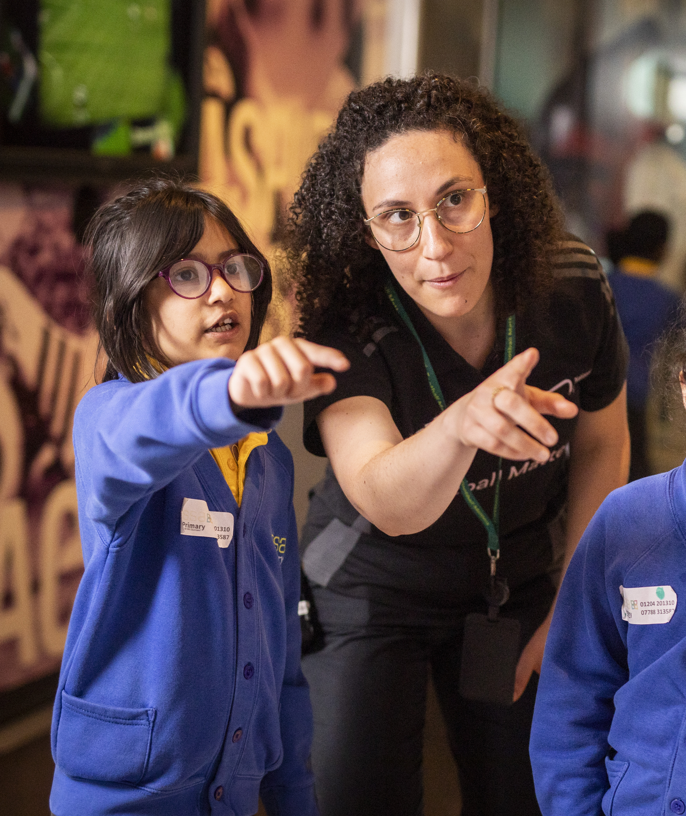
Please submit:
1. Your CV
2. A cover letter outlining how your skills and experience meet the criteria
3. Your completed equal opportunities monitoring form
Deadline for applications: Monday 28th June 2026
Submit to: recruitment@nationalfootballmuseum.com
If you require access support for your application, please contact us at recruitment@nationalfootballmuseum.com or call 0161 605 8200.
Please note: All applications must be made via the email above. We do not accept applications via LinkedIn. We reserve the right to close this vacancy early or re-advertise the position if a suitable candidate is not identified during the initial recruitment process.
Application Process
NFM is an equal opportunities employer, and we welcome applications from all individuals regardless of age, disability, gender, race, religion or belief, sexual orientation, or any other protected characteristic.
Further information to support your application, our EDI Policy and Privacy Statement can be found here: nationalfootballmuseum.com/jobs

