Slide 1

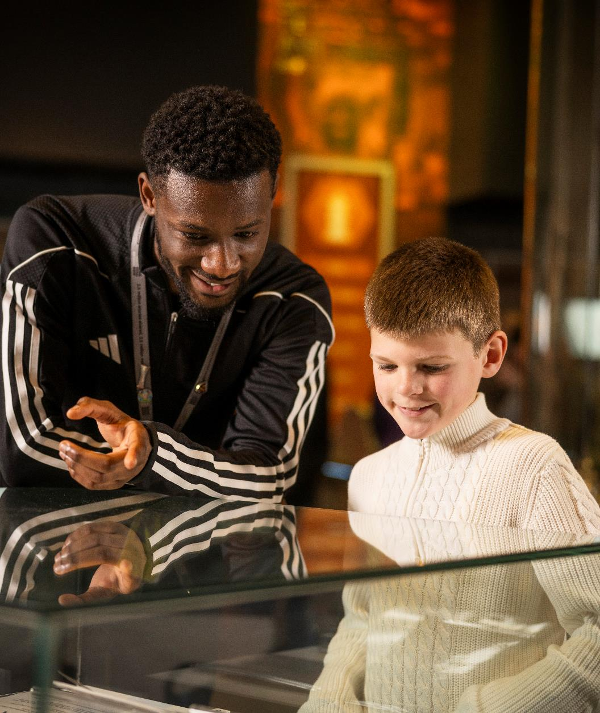
Senior Executive Assistant
(Fixed term 12 month, maternity leave cover)
Recruitment Pack

Slide 2

Contents
1. Football Matters
2. Who would this role suit?
3. Job description
4. Application process

Slide 3
Football Matters
Football is important. As a game, yes. But more so in its role in society. Football is a part of so much of people's lives. It creates impact, for the better. It represents positivity, when there’s so much negativity. It disrupts, when change is needed. It evokes and prompts emotions like nothing else. Its creativity is why it’s rightly known as The Beautiful Game.
Our Purpose
England’s National Football Museum (NFM) exists to house and harness the power of football, to share stories that influence, to showcase culture and involve and motivate people to creatively engage. It’s the place to experience football in all its glory, and the place to experience why football matters.
Our Values
Celebrating: Football is incredible
Football is known all over the world, and we have the honour to host so much of what makes it amazing. We are ambitious for our visitor experience and are proud of how positive people feel when they visit us.
Unifying: Football brings people together
In the passion for their team, for players they love, for the emotions of joy and heartbreak that football evokes, we tell the powerful story of this unification. At NFM, we provide a space where everyone can experience why Football Matters.
Exploring: Football has so much to offer
Football is good, bad and ugly at times. NFM allows people new to the game to understand it’s impact. And NFM shows people who have loved the game for years that there’s always something new for them to discover.
Evolving: Football disrupts to positively make change
Football transcends boundaries and represents the societal changes occurring every day. NFM is proud to be representative, taking action to drive inclusivity and diversity.
Enjoying: Football is fun.
NFM harnesses the fun of the game in its amazing visitor experience. People take part in our creative experience, and they are happy because they are involved. And happiness is a beautiful thing.

Slide 5
Who would this role suit?
Due to maternity leave this is a fixed term contract for 12 months.
The core role is to assist the CEO in all aspects of their work with the leadership team and trustees, supporting the delivery of key objectives and results and providing a comprehensive secretarial and administrative service.
This work further extends to supporting the Finance and Resources department in the development and delivery of Digital and Human Resources.
Proven Executive Assistant experience working with C-Suite level teams and boards of trustees or similar is essential as are strong organisational and communication skills.
We offer:
Competitive and sector-benchmarked salary
Hybrid working policy with a minimum three days a week in the museum in Manchester
25 days annual leave plus Bank Holidays
Medicash, Employee Assistance Programme, life assurance, cycle to work and regular wellbeing activities.

Slide 6
Job Description
Senior Executive Assistant
Department | Executive Office
Grade | C (£34,672 - £40,790 per annum)
Line Manager | CEO
Contract | Full time, fixed term, 12 months, (maternity leave cover)
Hours | 37.5 hours per week across 5 days, Monday to Friday.
Main Duties and Responsibilities:
The core role is to assist the CEO in all aspects of their work with the leadership team and trustees, supporting the delivery of key objectives and results and providing a comprehensive secretarial and administrative service.
This work further extends to supporting the Finance and Resources department in the development and delivery of Digital and Human Resources
Areas of responsibility and accountability
CEO
• Manage the CEO’s Communication Hub: Including but not limited to Outlook
calendar, emails, post, and calls
• Manage travel and accommodation arrangements for the CEO and SLT if required
utilising business relationships, always ensuring a time and cost-effective approach
and ensuring any policy requirements are adhered.
• Maintain an accurate record of CEO and VIP contacts database
• Maintain an accurate record of the staff organisational structure chart
• Support the CEO to build their external stakeholder networks
• Support the CEO and SLT with fundraising applications and reporting where
required
• Support the CEO with the communication and performance monitoring of SLT
through meetings, objectives and OKR setting
• Support the CEO to act as a sounding board by providing information and
organisational sourced feedback.
• Under the direction of the CEO, directly undertake or initiate investigations with
relevant stakeholders which will include the preparation of reports and submissions,
compile data and obtain information for the direct readership of the CEO.

Slide 7
Board of Trustees
• Collate & produce meeting/board packs, including power point presentations.
• Support the Senior Leadership Team and HR Manager with the preparation of
paperwork for quarterly Board of Trustees meetings, AGM, and quarterly committee
meetings, collating and distributing agendas and papers.
• To provide a secretariat capability, including an assistive governance capacity
where the CEO & SLT are in attendance on Board meetings, committee meetings,
SLT meetings, etc. From these, responsibility of prioritising actions & issues which
arise from such meetings for relevant action by relevant stakeholders.
Ensure the Board of Trustees meeting agendas and papers are distributed in a
timely manner in advance of meetings, with particular awareness of the Annual
General Meeting (AGM).
• Take minutes at Board of Trustees meetings, sub-committee meetings, and any
other trustee meeting
• Complete and submit information online for both the Charity Commission and
Companies House as required
Provide full administrative and secretarial support to the Chair of Trustees where required
Manage trustee recruitment advertising & applications and associated administration
Manage travel and accommodation arrangements for the Chair and Board of Trustees if required utilising business relationships, always ensuring a time and cost-effective approach and ensuring any policy requirements are adhered.
Resources (Digital & HR)
Administration and other ad hoc assistance for the HR Manager for existing employees
Assist the HR Manager with the administration relating to the recruitment of staff including advertisements, collating of applications, arranging interviews, completing HR files including references and assisting with the induction process
Effectively organise and administer the organisations electronic file management system, including files, databases, reference material, and SLT transcripts including that of other sources of information for use by the CEO & Finance & Resources Director (FRD).
Create and implement efficient processes to ensure proactive maintenance of administrative systems to autonomously manage first line co-ordination of correspondence and contacts
Coordinate and assist the Finance and Resources Director in the development and delivery of on an organisational wide strategy for the introduction of Artificial Intelligence (AI) Policies and Procedures. These policies and procedures will outline the approach adopted by the NFM for the interoperability and integration of AI capability into our mission, where required
Coordinate and assist the Marketing, Communication and Development Director (MCDD) on the development and delivery of an organisational wide strategy for the SharePoint migration, where required
Support with Staff Engagement and Wellbeing/ Staff Engagement including but not limited to conducting more in-depth wellbeing initiatives
Assist and coordinate team day schedules as directed

Slide 8
General SLT support
• Provide administration support for team meetings and training days
Ensure that CEO approved SLT external meeting agendas and papers are distributed in time for meetings and subsequently take minutes and follow up on actions.
Support SLT in the administration of Safeguarding Group, including meeting agendas and papers are distributed in a timely manner in advance of meetings, and prioritising actions and following up on these.
Be the central co-ordinator of all electronic master documents and procedural documents relating to the Organisation which will include editorial, auditability and document control.
Support CEO finance information for submission to the Finance department. Including but not limited to monthly payroll, expenses, purchase orders, etc.
Managing a budget on behalf of the CEO, the SLT, Trustees for their associated costs
Support SLT in the management of Data Protection and active involvement within the Data Protection Forum, including meeting agendas and papers are distributed in a timely manner in advance of meetings, and prioritising actions and following up on these.
Ensure that the correct level of confidentiality is applied to all aspects of work conducted by the CEO, Senior Leadership Team, HR and Trustees.
Qualifications, experience and skills
• Proven experience as an Executive Assistant
Experience with working with Project Management/CRM systems
Experience of working at C-Suite level with Boards of Trustees or similar
High degree of IT literacy – including using the full suite of Microsoft Office Programmes (including SharePoint, MS Outlook and PowerPoint) with the ability to learn new software packages quickly
Professional or vocational qualification in Administration or equivalent qualification
Strong organisational skills and document control
Excellent verbal and written communication skills – able to write coherently and effectively
Ability to assimilate and effectively deal with important and confidential and sensitive information
High degree of strategic, diplomatic and social skills – confident communicating effectively at all levels and with a diverse range of stakeholders
Able to act on own initiative, prioritise and meet deadlines
Proven ability to take and produce professional meeting minutes whilst managing actions and follow ups
Effective diary management
Eye for detail and ability to proofread with attention to spelling and grammar
Team player
Work well under pressure and changing circumstances
Budget management and expense processing experience
Analytical thinking and problem-solving

Slide 9

Please submit:
1. Your CV
2. A cover letter outlining how your skills and experience meet the criteria
3. Your completed equal opportunities monitoring form
Deadline for applications: Monday 28th June 2026
Submit to: recruitment@nationalfootballmuseum.com
If you require access support for your application, please contact us at recruitment@nationalfootballmuseum.com or call 0161 605 8200.
Please note: All applications must be made via the email above. We do not accept applications via LinkedIn. We reserve the right to close this vacancy early or re-advertise the position if a suitable candidate is not identified during the initial recruitment process.
Application Process
NFM is an equal opportunities employer, and we welcome applications from all individuals regardless of age, disability, gender, race, religion or belief, sexual orientation, or any other protected characteristic.
Further information to support your application, our EDI Policy and Privacy Statement can be found here: nationalfootballmuseum.com/jobs

